Slide 1
Scalability

Slide 2
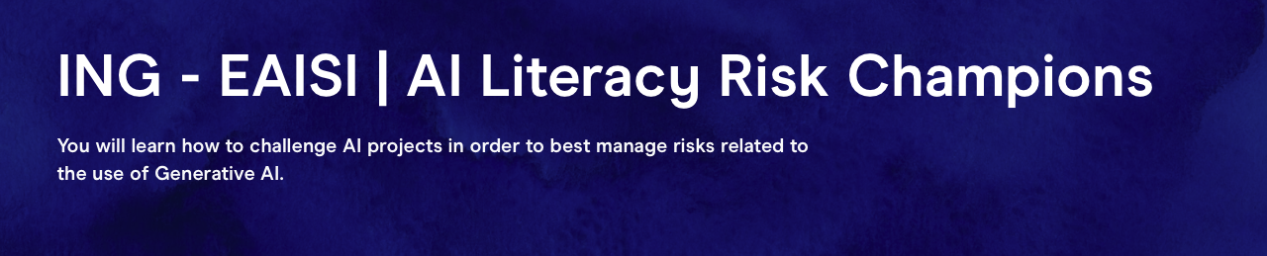
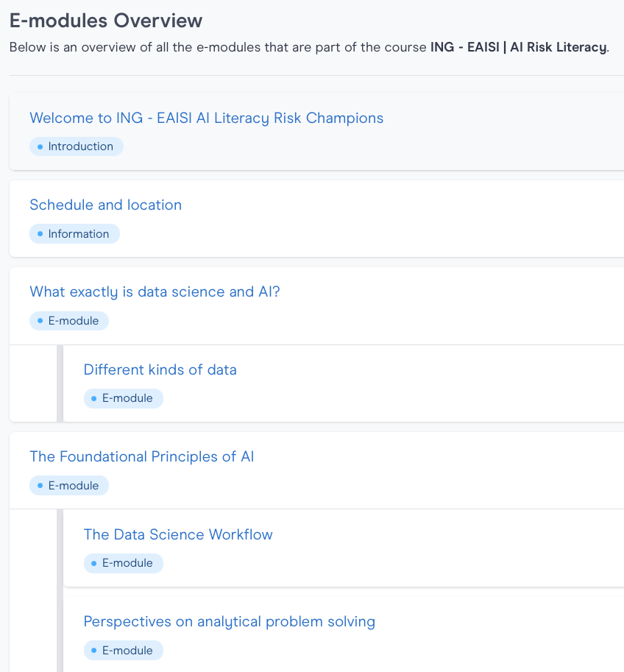

Agenda
Topics for today:
Mitigation Strategies
Controlling and Improving
Scalability
Case Study
Closure
Notes:
Mitigation strategies: guardrails , design choices, system prompt, series of LLMs checking, role of human in the loop
Controlling and improving: reference sets daily fired through, monitoring, logging, experimentation
Scalability – getting a nr of components rights such as RAG, tone of voice, monitoring&logging, but also defining risk appetite or a WAY to figure out during pilot testing how to define an acceptable range

Slide 3
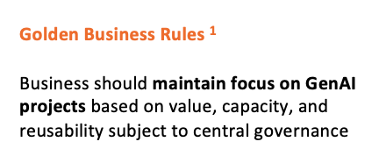
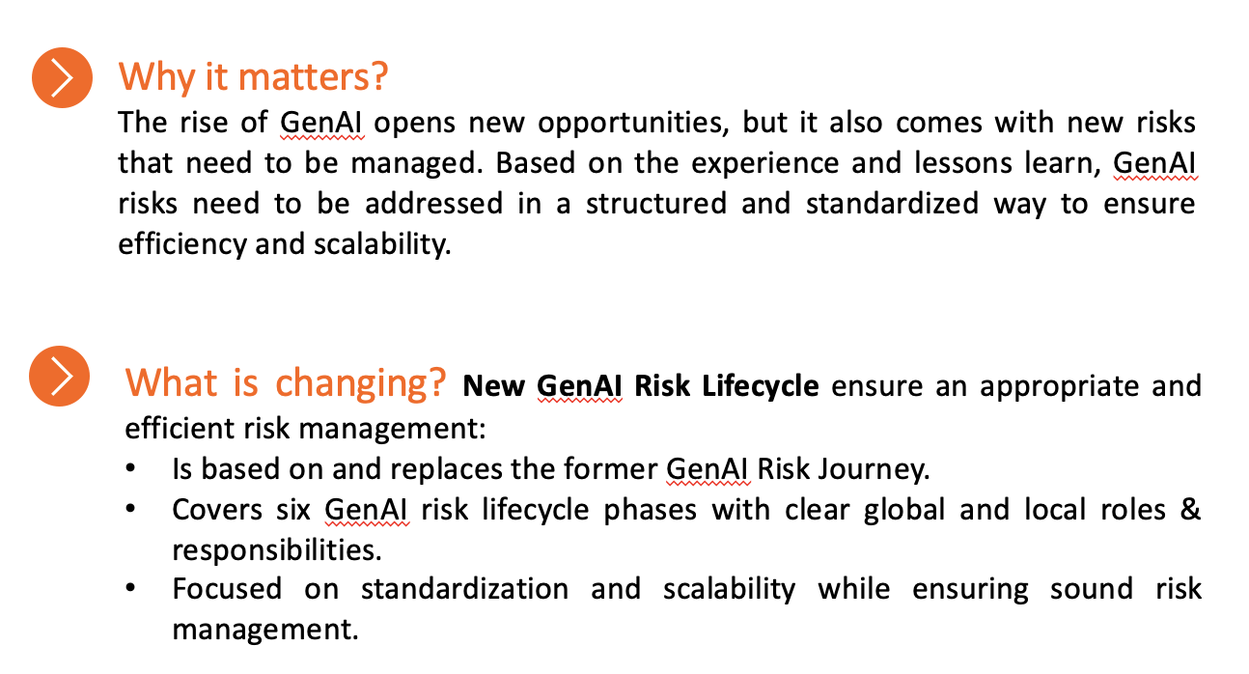
The GenAI risk lifecycle aims for scalability / reusability / efficiency
Notes:
Because we are only interested in one

Slide 4
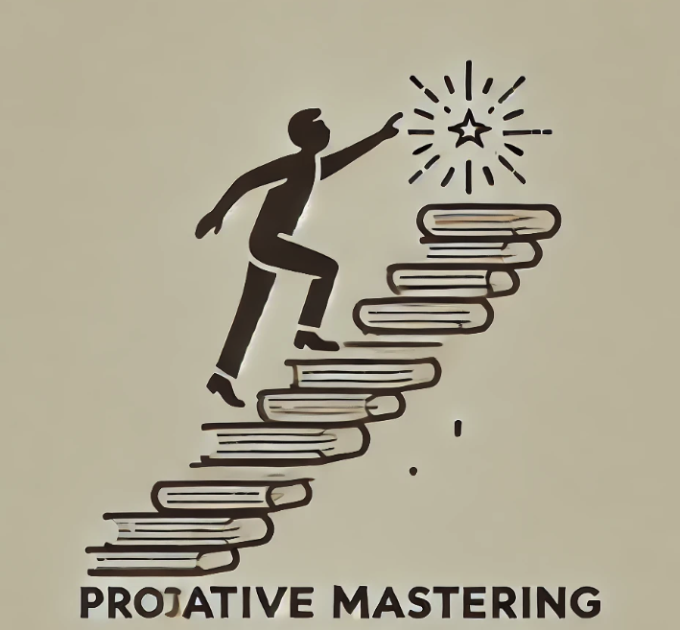
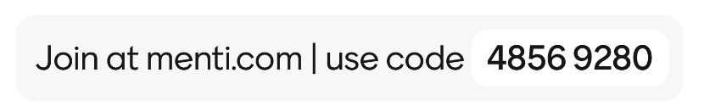
Getting reusable components right (one at a time)
Things that will be important in the great majority of GenAI use cases should be mastered proactively:
Controls / process around a knowledge base
Standard set of guardrails
ING’s tone-of-voice
Etc.
Scalable & Actionable Monitoring of every detail of a GenAI application
Automated assessment of the application after a data or design update
The ability to define risk appetite
What approach to take when defining a risk appetite?
Notes:
Proactively, so not when the next use case is presenting itself
A tone-of-voice guardrail should be approached as a separate project.
Proactive mastering would suggest running an extensively used test-LLM-application, for internal use, to be the guinea pig on which all these things are developed

Slide 5

If you don’t, you risk getting stuck in these tradeoffs
Data freshness versus Data curation
Reducing the risk of generating wrong information based on stale data, might increase other data-related risks (biased data, etc.)
Privacy risk vs Fairness
Sensitive attributes are ideally replaced by neutral terms
But your use case might require different behavior for people with differing values on sensitive attributes, e.g. :
different advice on pension plans or mortgage based on different age brackets, but this increases overall stereotypical tendencies of the model
in which case stronger guardrails are needed
Notes:
Inherent risk tradeoffs, but the better you are in organizing your controls, the less of a price you pay
You need to be good at replacing sensitive attribute values by neutral terms, and recognizing when this is and is not the right thing to do, and which additional guardrails you need when sensitive attributes need to stay in.

Slide 6

Prepare for scale
What is needed to implement and monitor 100 GenAI applications in one year from now?
What will be the biggest challenge?
The process?
The people?
The tooling?
Something else?
Notes:
an application not being recognized as a GenAI application in the organization, and therefore evading the required workflow

Slide 7
People, …
People (collaboration & alignment)
Roles and responsibilities - Who owns what? How to prevent silos? Where do responsibilities start and stop?
Decision making & governance - Who has authority?
Communication & knowledge sharing – How to stay aligned?
Culture & team dynamics – How to foster collaboration and adaptability?
Skills and training – Are certain skillsets missing or underrepresented?
Capacity – Are more FTE needed to handle scale?
Notes:
Just as a framework…
I don’t care about the details –
focus on the BIG things –
what makes a difference to get absolutely right when there are 100 applications coming your way
I rather have 2 stickies with BIG things, then 14 stickies with details…
Because we end with a discussion on how to

Slide 8
People, Process, …
Process (scalability & efficiency)
Workflow design – are tasks structured for efficiency?
Standardization & reusability – what needs to be consistent, what can be flexible?
Efficiency and automation – where to remove manual inefficiencies?
Metrics and continuous improvement – how to measure performance and continuously optimize?
Notes:
Just as a framework…
I don’t care about the details –
focus on the BIG things –
what makes a difference to get absolutely right when there are 100 applications coming your way
I rather have 2 stickies with BIG things, then 14 stickies with details…
Because we end with a discussion on how to

Slide 9
People, Process, Tooling
Tooling (technology & enablement)
Collaboration tools - What tools do we use for communication & workflow?
Data & Reporting systems - How do we track progress and make data-driven decisions?
Tech integration - Are our tools working together, or are they creating friction?
Automation & AI - What technologies can help us scale without adding more manual effort?
E.g. is there a place where lessons learned from previous risk assessments and mitigations can be logged?
Notes:
Just as a framework…
I don’t care about the details –
focus on the BIG things –
what makes a difference to get absolutely right when there are 100 applications coming your way
I rather have 2 stickies with BIG things, then 14 stickies with details…
Because we end with a discussion on how to

Slide 10
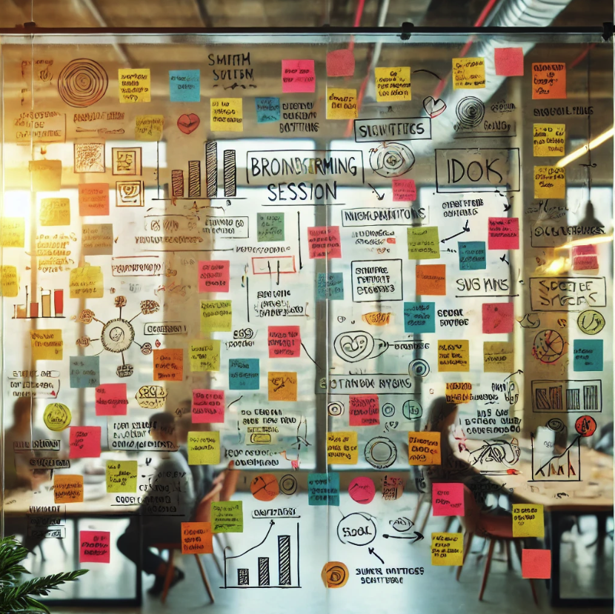
The assignment
What are the biggest challenges to ING in the coming period?
Notes:
Just as a framework…
I don’t care about the details –
focus on the BIG things – I don’t care about the 100 things to take on, I care about the 2 things to take on.
You are allowed 2 stickies, and then all the other things you think of, please do write them down to share afterwards, but not now…
So - what makes a difference to get absolutely right when there are 100 applications coming your way
I rather have 2 stickies with BIG things, then 14 stickies with details…
Because we end with a discussion on how to
AND… now imagining everything the process AS IS, not with all their improvements proposed. Because you propose 15 things, and I want to know the next 3 things to take one…

Slide 11

This will be a team effort (Guild) - which piece of the puzzle do you want to bring to the table?
Notes:
Just as a framework…
I don’t care about the details –
focus on the BIG things – I don’t care about the 100 things to take on, I care about the 2 things to take on.
You are allowed 2 stickies, and then all the other things you think of, please do write them down to share afterwards, but not now…
So - what makes a difference to get absolutely right when there are 100 applications coming your way
I rather have 2 stickies with BIG things, then 14 stickies with details…
Because we end with a discussion on how to
AND… now imagining everything the process AS IS, not with all their improvements proposed. Because you propose 15 things, and I want to know the next 3 things to take one…

Slide 12
Reflection
Notes:
Together as

Slide 13
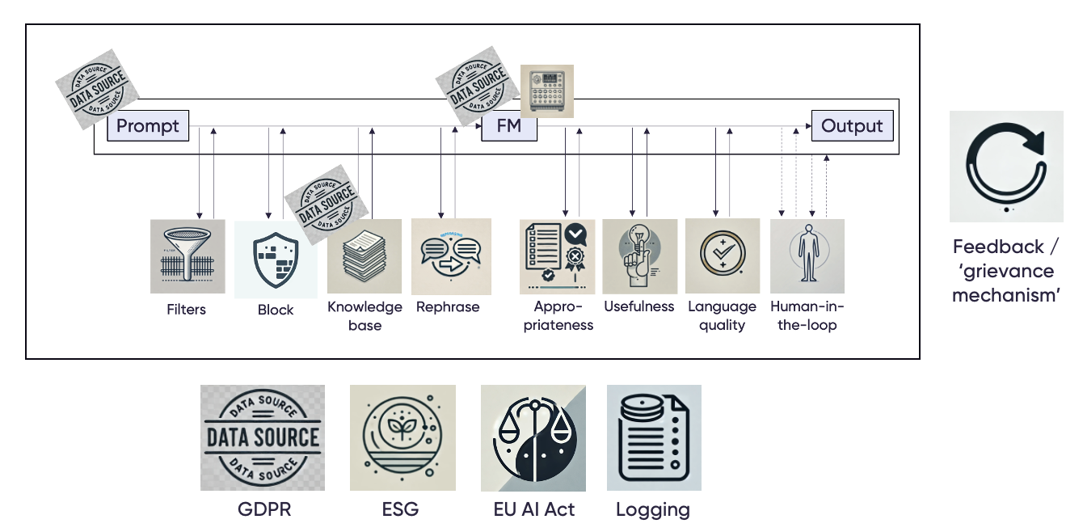
Mitigation strategies
There are a few fundamental approaches to countering potential risk:
Stop the application (or lower the ambition)
Human in / on the loop
Guardrails
Design choices
Data curation
0)
Notes:
Optionally, take this to day 3 and link it to how this could be used as operationalization of rule-based logic AND then linked to the chatbot at DP

Slide 14
Getting reusable components right (one at a time)
Things that will be important in the great majority of GenAI use cases should be mastered proactively:
Controls / process around a knowledge base
Standard set of guardrails
ING’s tone-of-voice
Etc.
Scalable & Actionable Monitoring of every detail of a GenAI application
Automated assessment of the application after a data or design update
The ability to define risk appetite
Notes:
Proactively, so not when the next use case is presenting itself
A tone-of-voice guardrail should be approached as a separate project.
Proactive mastering would suggest running an extensively used test-LLM-application, for internal use, to be the guinea pig on which all these things are developed

Slide 15
Case Study

Slide 16
Wrap-up of the bootcamp
Notes:
Together as

Slide 17
This will be a team effort (Guild) - which piece of the puzzle do you want to bring to the table?
What is your ticket into future projects, that will help you quickly build up a project portfolio?
Notes:
And this will become more and more crucial with the rise of agentic AI. Risks will increase exponentially, the landscape will become more and more complex, so it will become more and more important collaborate with a larger group of experts becoming more and more specialized regarding the different pieces involved.

Slide 18
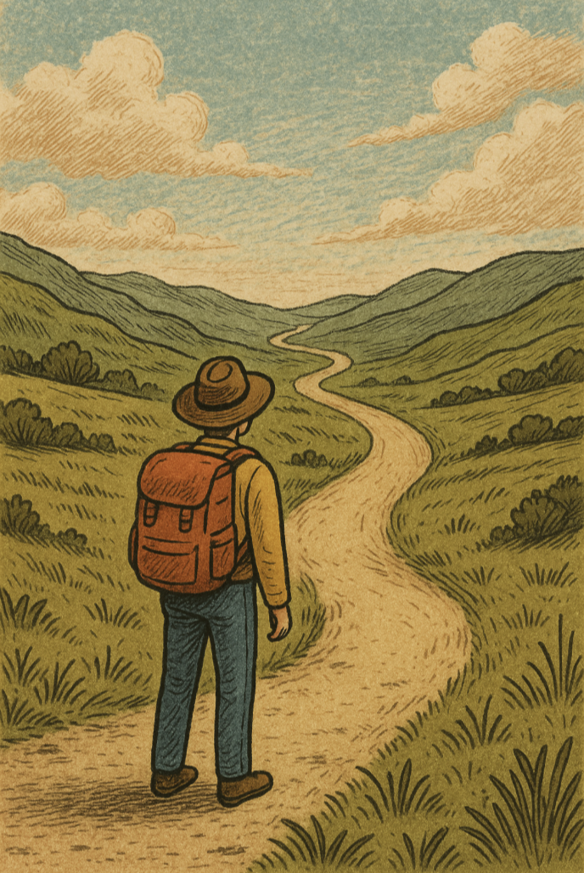
This is only the beginning
This is all about building up experience and continuous learning
(which won’t hurt your career)
Don’t ever hesitate to reach out
Refer to the online learning platform if needed
Stay up to date:
https://www.youtube.com/@matthew_berman
https://www.youtube.com/@WesRoth
But, most importantly, do it together within the Guild!
E.g. by sharing your learnings, projects,, offering your expertise, etc.
Biggest take-away of the training?
Notes:
E.g. by sharing your biggest take-aways / learnings

Slide 19


Slide 20
Bootcamp - AI Literacy Risk Champions Program
Ways to mitigate risk
Joran Lokkerbol | January 15, 2026

Slide 21



‘Data Quality’ - timeliness
The closer the data to the consumer, the more important it is for the data to reflect the current state of the system:
Real-time responses
Customer-facing
A process must be established where the knowledge base is synced with the underlying documents

Slide 22

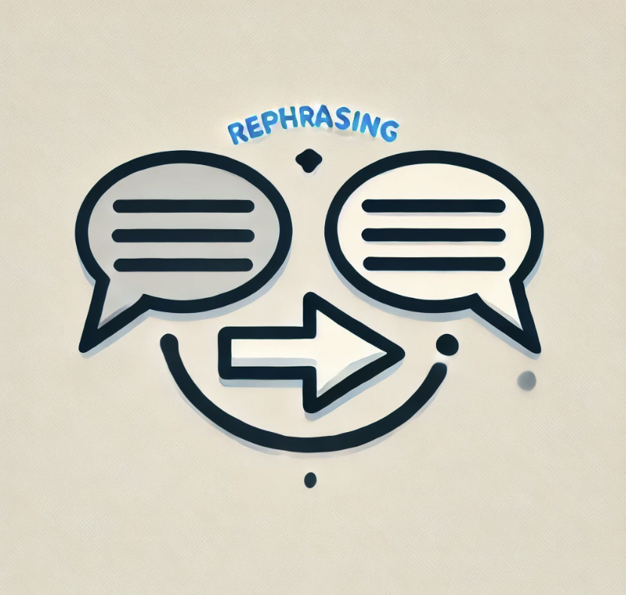



If you don’t, you get stuck in these tradeoffs
Nevertheless, the improvement related to typical limitations is very often worth it
Hallucination – the model producing incorrect or misleading information
Specificness – the model lacking information about the company
Timeliness – the model not having access to the most up to date information
Prompt
FM
Output
Knowledge base
Rephrase
Appro-priateness
Usefulness
Human-in-the-loop
No sensitive data
No stereotyping
Retrieval Quality
Notes:
Frequent curation […]: either removing sensitive information, sensitive attributes, or making sure the knowledge base does not contain contradicting documents

